Slide 1
Spatial and Temporal Trends of Fine Particulate Matter in Western Oregon
Makoto Kelp

Slide 2
What is Particulate Matter (PM)?
Aerosol: total amount of suspended solid and liquid particles in the air.
PM:
Class of Aerosols
Natural and Anthropogenic Sources
Result of Incomplete Combustion:
H_{x}C_{x}+ O₂ → H₂0 + CO₂ + heat + charred PM
PM_{2.5} or Fine PM
2.5 refers to diameter of the particle
“Fine” because not discernable to the human eye
Sources: fine PM may form from inefficient combustion due to motor vehicles, residential wood burning, and other local industrial processes.

Slide 3
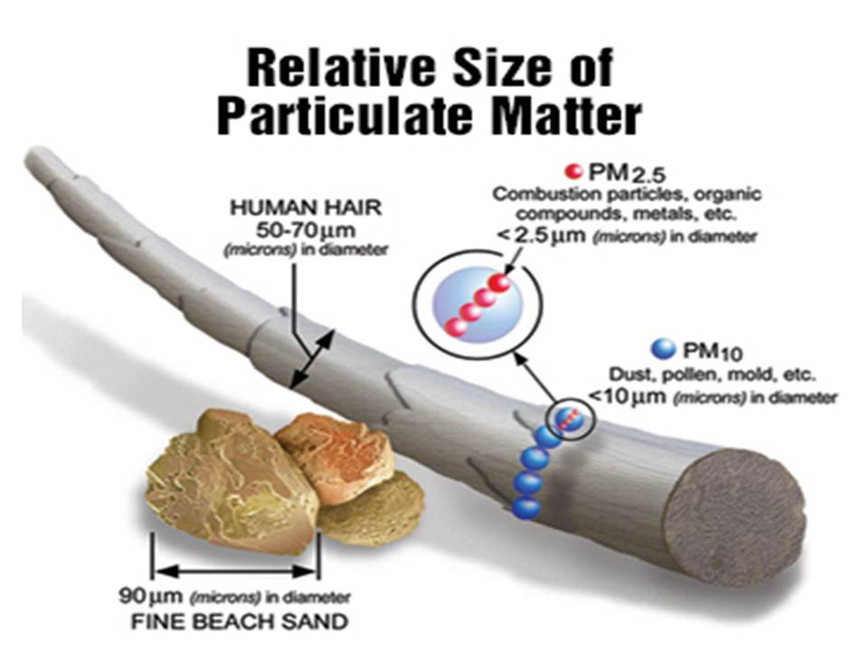
Relative Size

Slide 4

Health Effects of PM: Lung Deposition

Slide 5
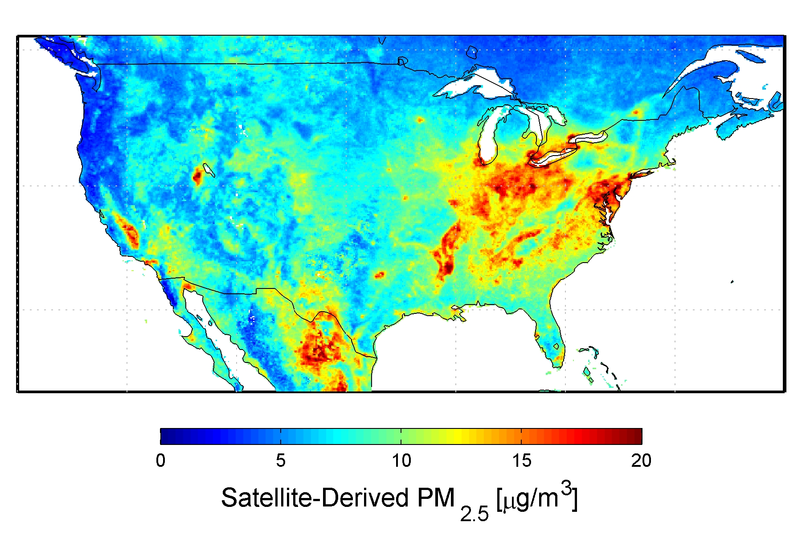
National Trends, Global Radiative Effects

Slide 6
Data
Supplied by Anthony Barnack (upon request) from the Oregon Department of Environmental Quality (DEQ)
Period of two years from January 2013 to December 2014
Data: PM_{2.5} concentration in micrograms/m3 at nine different monitoring sites from Western Oregon including SE Lafayette in Portland to Salem, Corvallis, etc.

Slide 7
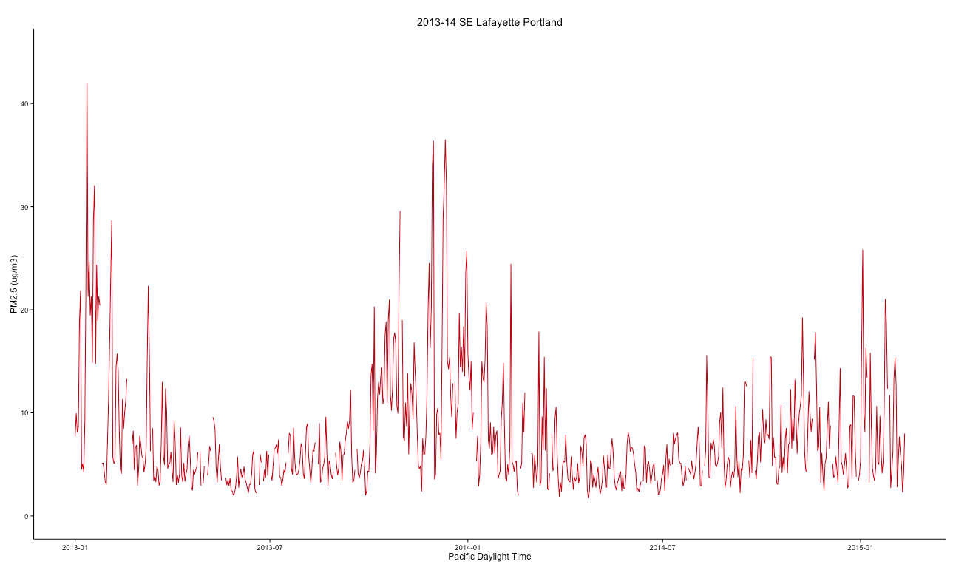
Exploratory Data Analysis
Notes:
1) This shape is due to the fact that there is more combustion activity in the winter (think home heating) than in the summer. If we assume that PM's sink is deposition and assume the same rate of deposition for all seasons, then it makes sense that the season with the highest rate of production (winter) will have higher overall concentrations.
2) "Fine particles also have seasonal patterns... Fine particle concentrations tend to be higher in the fourth calendar quarter (October-December) in many areas of the West, in part because fine particle nitrates are more readily formed in cooler weather, and wood stove and fireplace use produces more carbon. TREES
3) One must also note that PM is highly susceptible to specific source events that can drive the average up for a period of time (such as a fire or congregation of old diesel trucks).

Slide 8
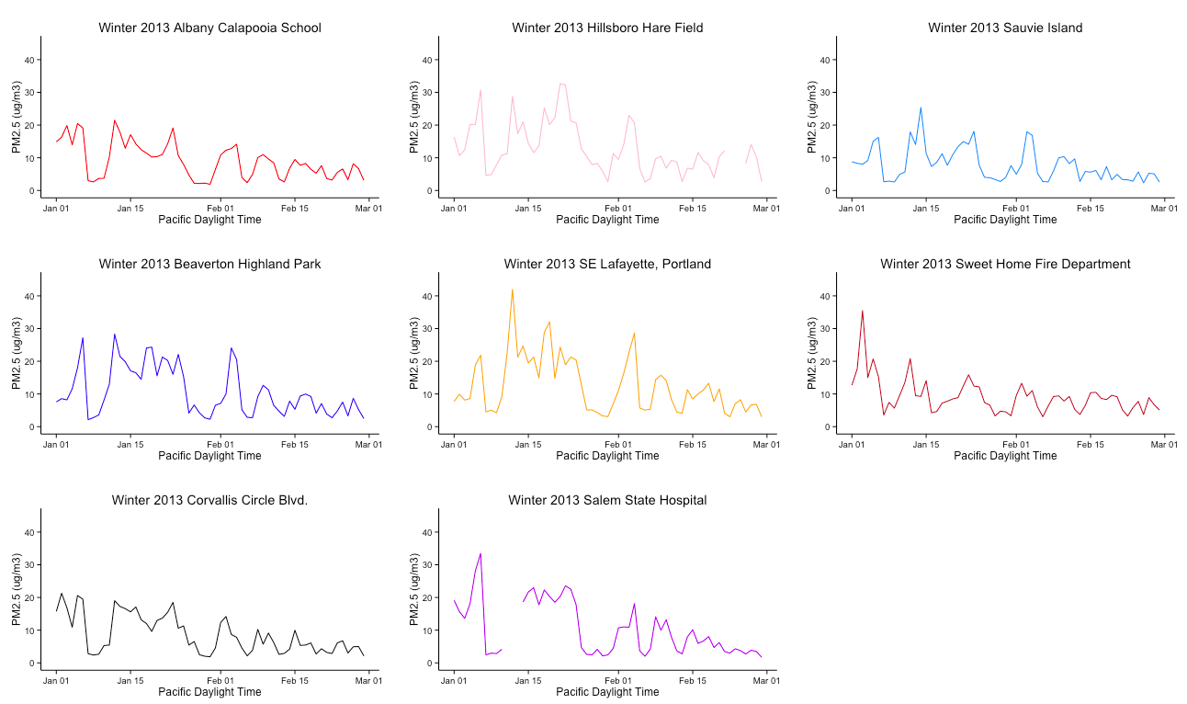
Winter 2013
Notes:
Note: Spikes line up, magnitude

Slide 9
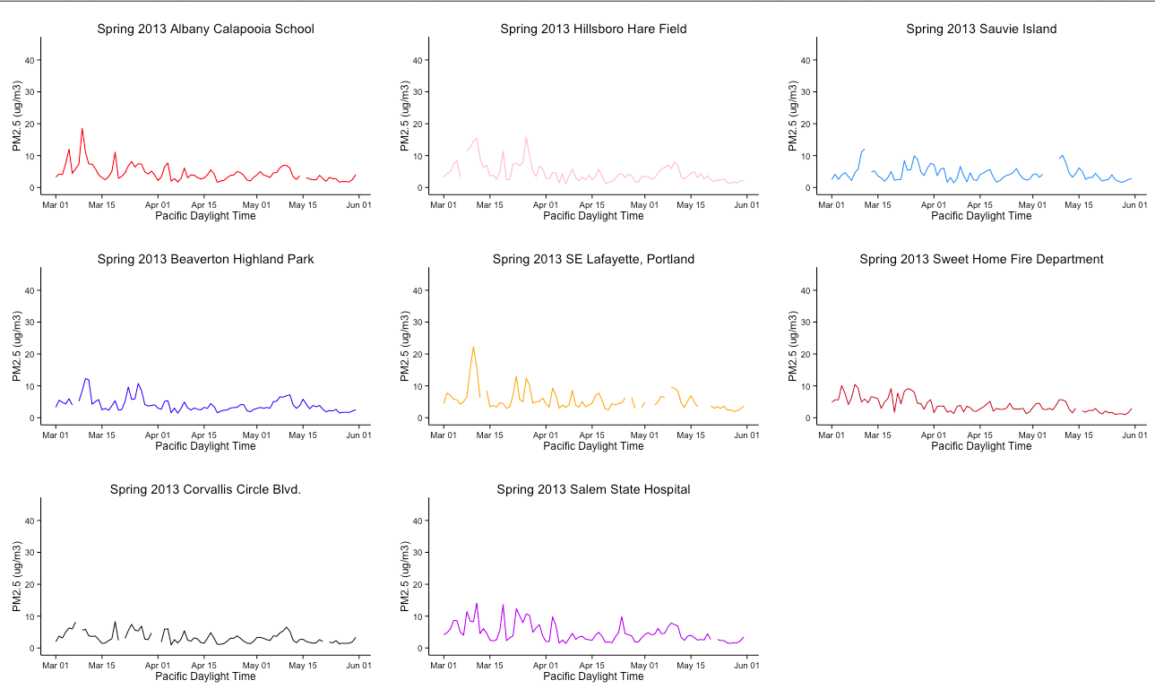
Spring 2013
Notes:
Smaller magnitude (Same scale), spikes also line up

Slide 10
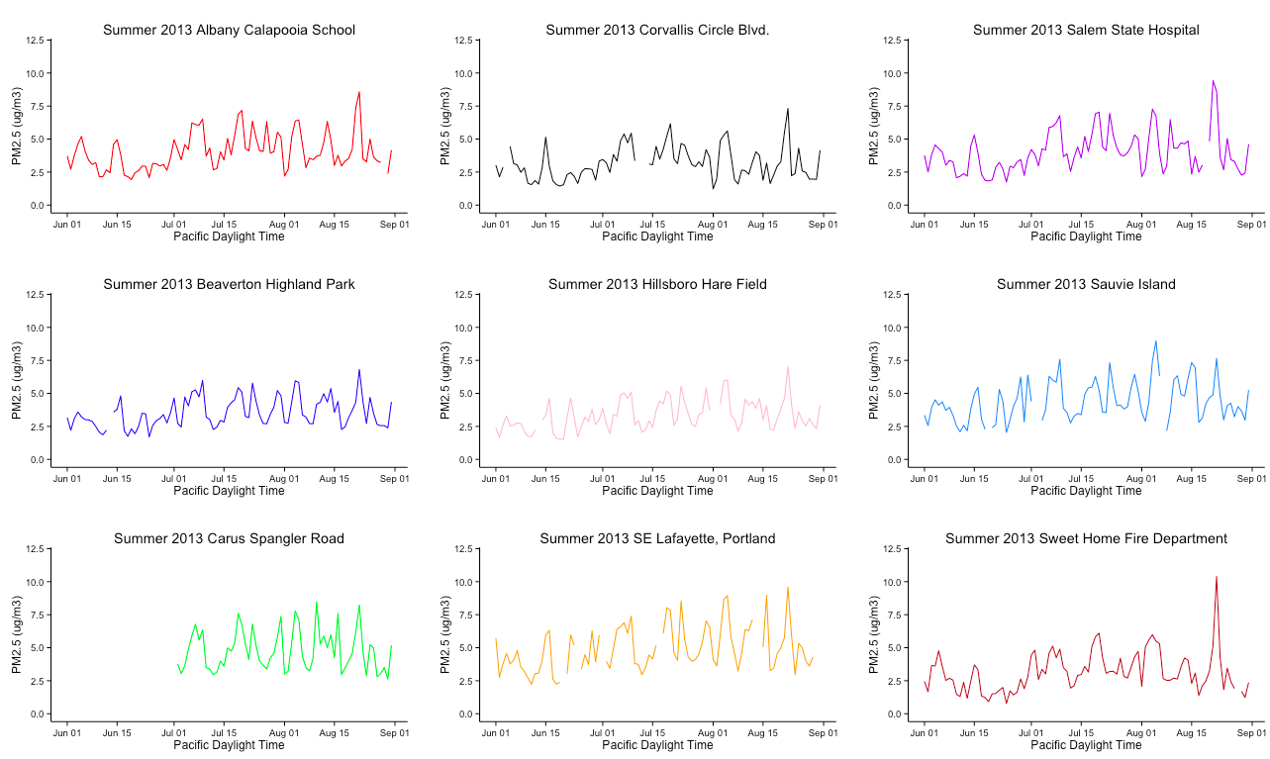
Summer 2013
Notes:
New scale, note magnitude much smaller, talk about individual events driving each day

Slide 11
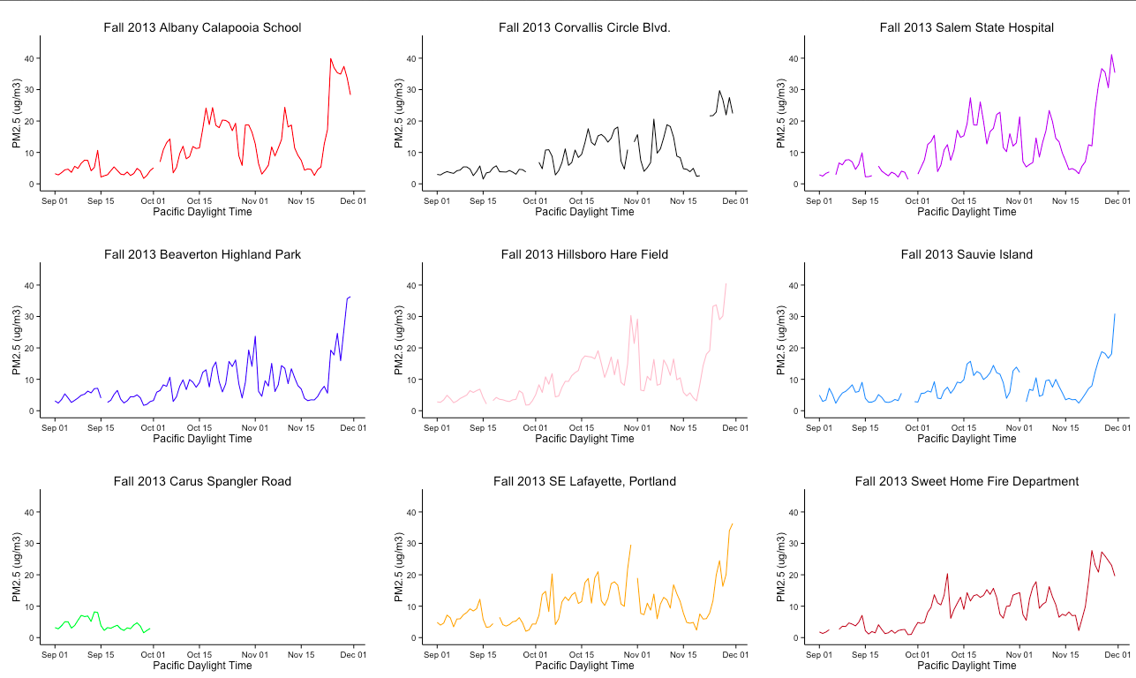
Fall 2013
Notes:
Magnitude increasing back up again as in winter, note the last increasing peak in all data→ what is this? See next few slides and talk about are there in season patterns?

Slide 12
Seasonal Mean Concentrations
Use Portland as a Comparison!

Slide 13
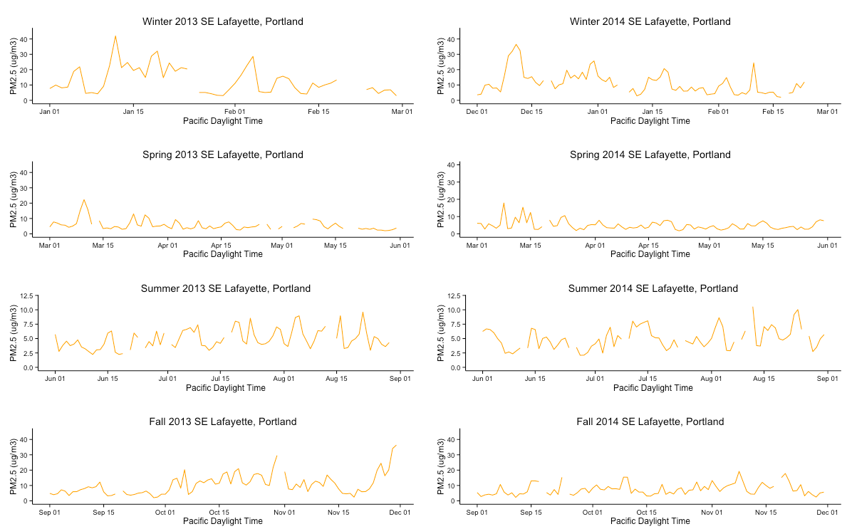
Temporal Variations: Lafayette
Notes:
Trends? Not really
Seems random with peaks, except maybe large peak in fall 2013, 14? See next slide

Slide 14
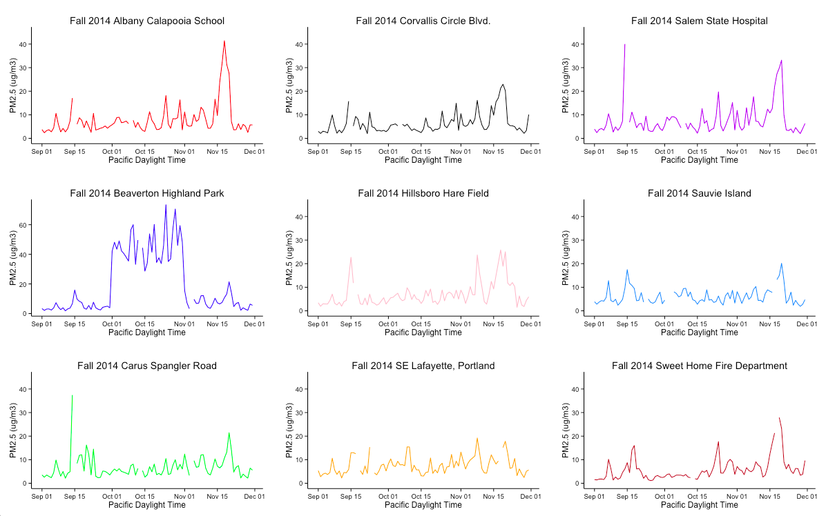
What Happened Here? A lesson in Exploratory Data Analysis
Notes:
Beaverton data corrected → 60 ug is crazy! Beijing Levels
Large peak events near end? High influx of wood burning? Near Holidays? Higher rates of travel?

Slide 15
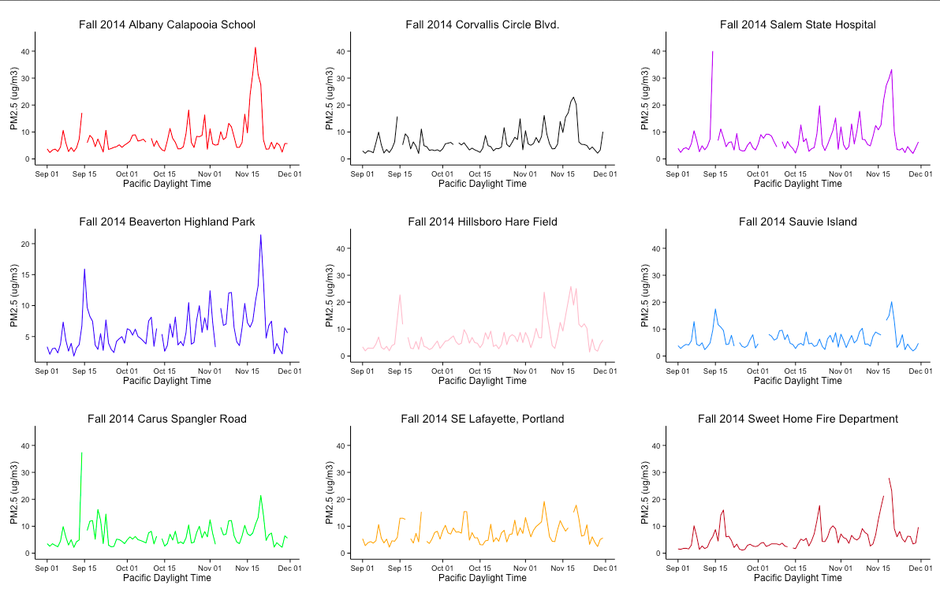
That’s Better

Slide 16
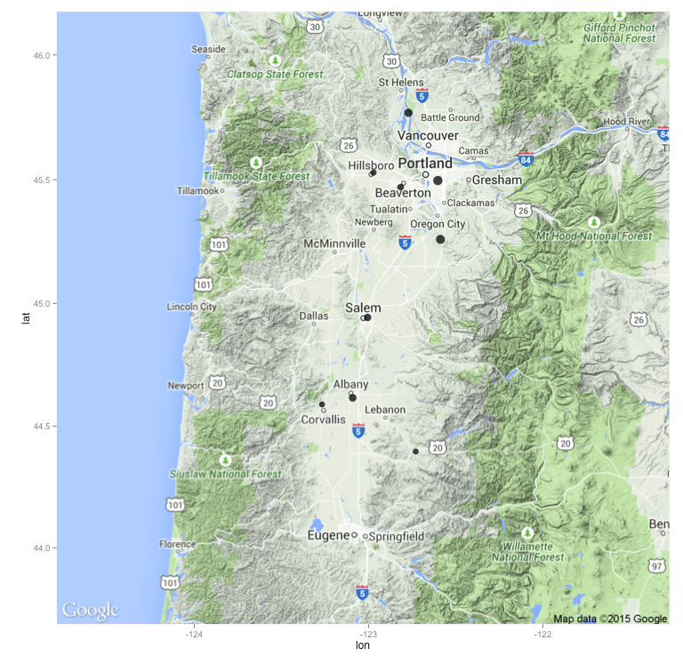
Map of Western Oregon Summer 2013

Slide 17
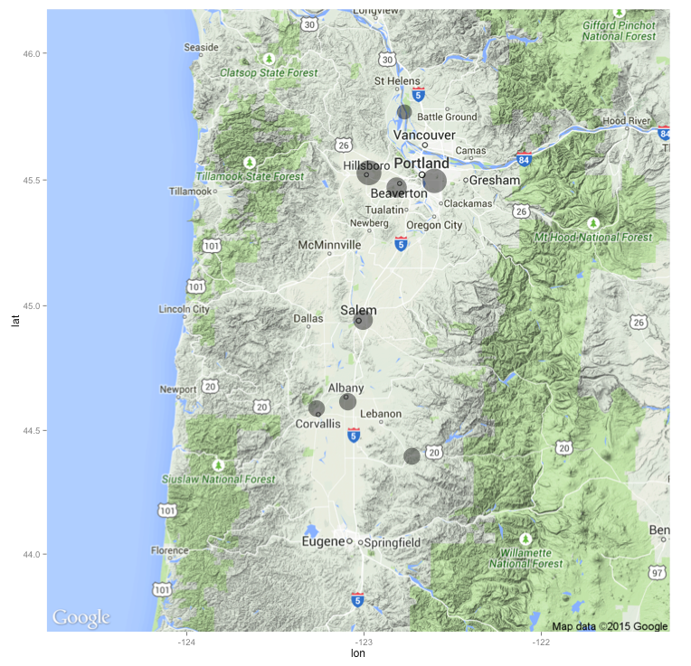
Map of Western Oregon Winter 2013

Slide 18
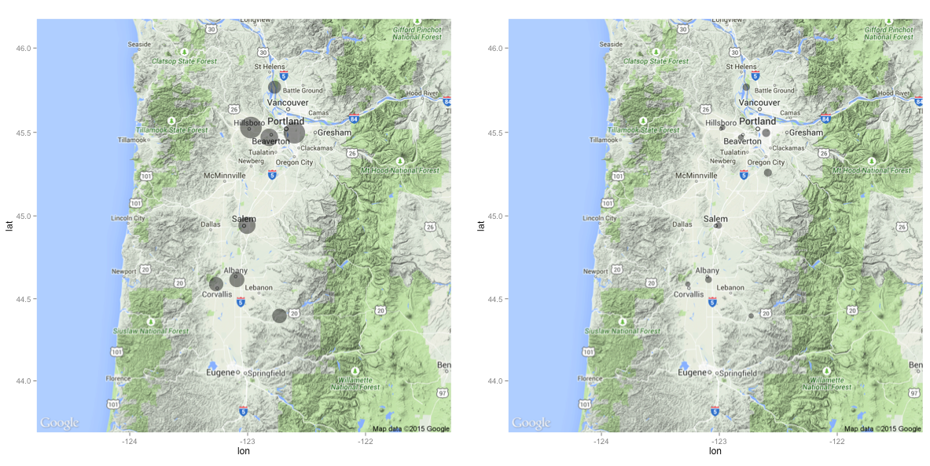
2013 Seasonal Comparison
Notes:
Urban Areas = more PM! duh

Slide 19
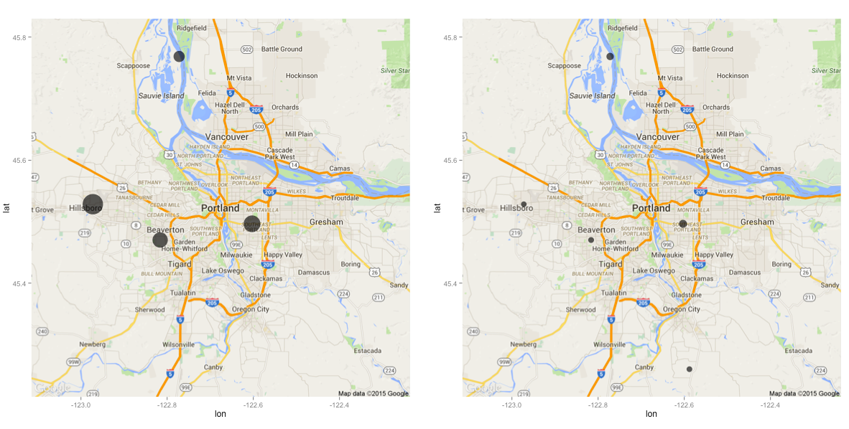
Portland 2014 Comparison
Notes:
Sauvie Island is very weird, lots of organics (fertilizers, Organic matter) in the air, how can we test?

Slide 20
Point Sources, More than Convenient Averages
Notes:
Notice not smooth line, but rather series of individual events

Slide 21
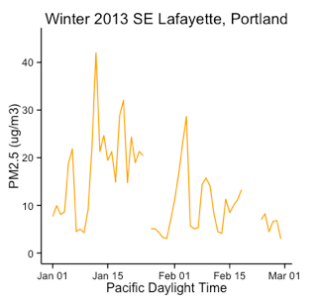
Closer Look
42.0000 micrograms/m3
Monthly Average: 12.7897 micrograms/m3
Notes:
Although we derive a monthly average value from these of 12.7897 ug/m3, these values are from peak events that are much higher than that value,
What does this mean in terms of health?

Slide 22
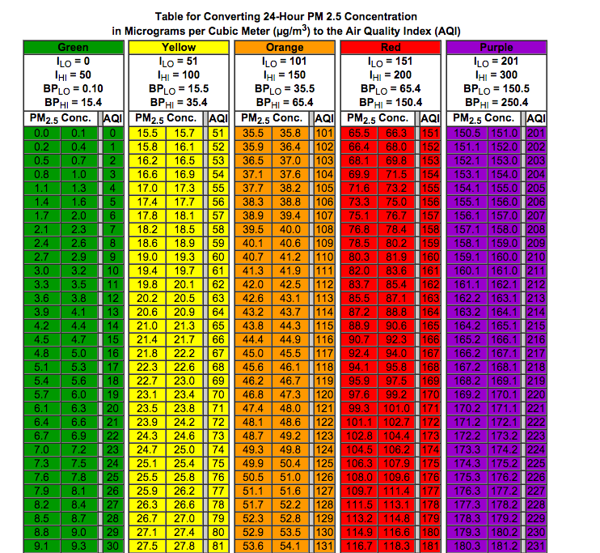
Average = Green
Peak = Orange

Slide 23
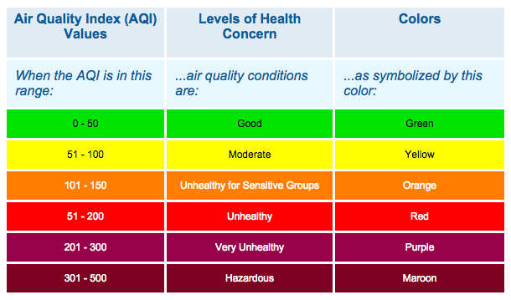
AQI

Slide 24
Conclusions
Variable Depending on Region
Annual Pattern: Peak in Winter, Low in Summer
Dependent on combustion activities (industry, vehicles, home heating) and Temperature
No statistically significant In-Season Pattern
Urban Areas (PDX) produce PM than rural areas
Significance of Peak Events and Point Sources

Slide 25
Extensions
ARIMA (Autoregressive Integrated Moving Average) calculation that may help determine the "staying power" of a pollutant, that is, its potential atmospheric lifetime.
Using larger data set do ID more seasonal patterns and potentially link them to specific events

Slide 26
Acknowledgements
Albert Kim and Math 241
Julie Fry, Ben Ayres, Reed Chemistry Department
Anthony Barnack and Kevin Downing from the Oregon DEQ

